Slide 1
Module 4: The vacillating Giant
Talk | Title | Time Period | Date of Talk
23 | USA and the 20th Century | 1898-1900 | September 2nd
24 | The Progressive era | 1900-1916 | September 16th
25 | USA and world War One | 1914-1918 | October 21st
26 | The retreat to “normalcy’ | 1918-1920 | November 4th
27 | The Roaring Twenties | 1921-1929 | November 18th
28 | Great Depression and New Deal | 1929-1938 | December 2nd
29 | USA and the 1930’s world | 1932-1939 | December 16th

Slide 2
American History
1
Talk 29: Great Depression and New Deal (1929-1938)
Part Two

Slide 3
Responses to the Depression

Slide 4
The Republican response
Herbert Hoover….1932
“It is not the function of the government to relieve individuals of their
responsibilities to their neighbours, or to relieve private individuals of their
responsibilities to the public.”
Andrew Mellon, Secretary of Finance
"liquidate labour, liquidate stocks, liquidate the farmers, liquidate real
estate. Purge the rottenness out of the system. High costs of living and
high living will come down. ... enterprising people will pick up the wrecks
from less competent people."

Slide 5
Response 1 Increase Tariffs
The history of US tariffs
1870-1913) …average rate 40%....policy to protect industry & grow
1913-1920 …..Wilson Administration …reduced rates to 10%
1920……..Post war Recession increased rate to 15%
The Republican solution 1930
Senators Smoot & Hawley propose 50% tariff increase
Hoover initially opposes…committed to International cooperation
Refuses to veto bill…( Head of JP Morgan “I practically fell on my knees to beg the President to veto this stupid bill”)

Slide 6
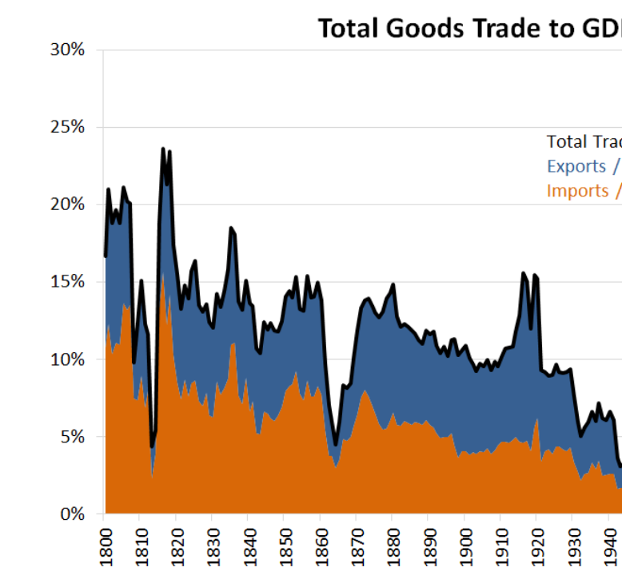
The result ….retaliation and 60% drop in exports & imports …”international trade” shrinks from 15% to less than 3% of economy

Slide 7
Response #2: Immigration control
1920’s Immigration
National quotas ….immigration northern European 200,000/ year
Border Patrol to Mexican border created 1924….visa system
Hoover administration “American jobs for American workers”
Reduce immigration quotas…from 3% to 1/6% of population 1900 by country…reduces from 200,000 to 20,000
Enforce legal deportation
Encourages Employers to replace immigrant with “American worker”

Slide 8
Repatriation/ Deportation Drives
State and Local Government initiatives
“Round ups” at local charities, hospitals
Intimidation/ paid bus and trains.
Mexican agreement “Cardenista” reforms
Forced proof of identify and citizenship to secure work
Return to families or agricultural cooperatives
California at the front
Influx of “Oakies”….. zero hiring of Mexicans
Los Angeles Hospitals clear out
1960’s California State “Letter of Apology”
1 million “Mexicans” return ‘voluntarily” 1930-190 , 80,000 deported

Slide 9
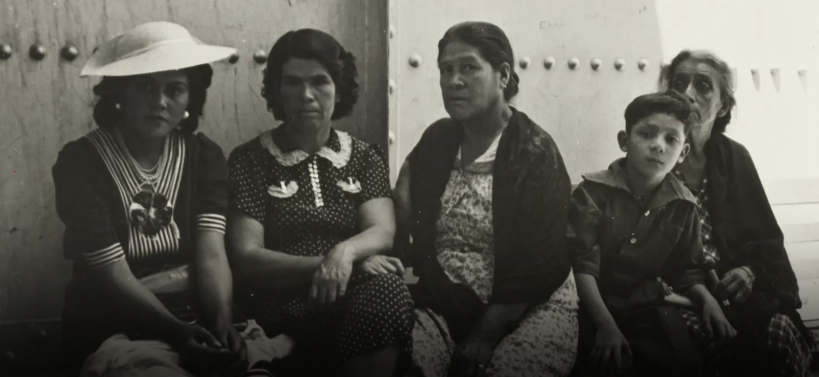
Waiting to return

Slide 10
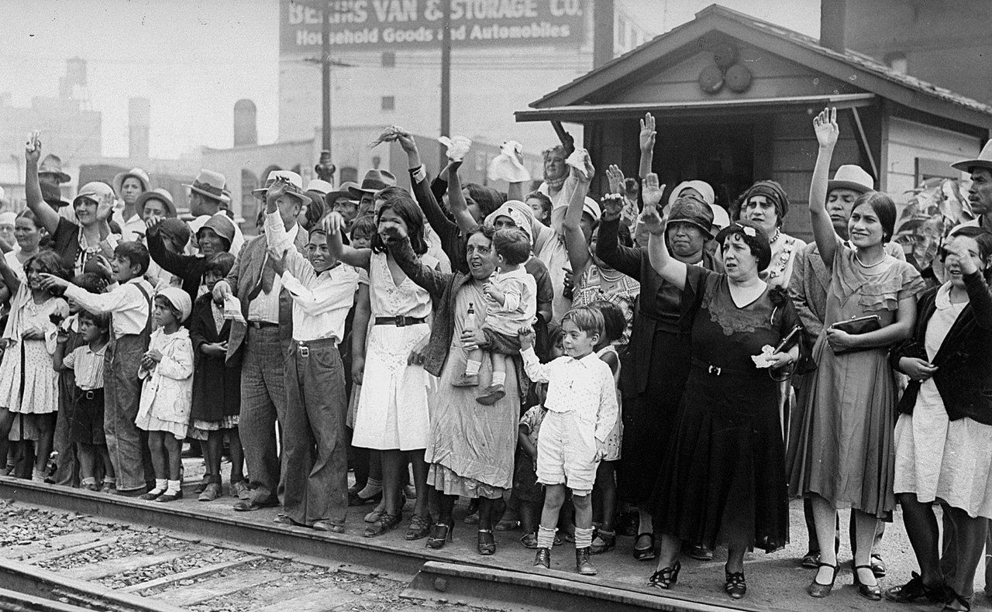
Waving goodbye

Slide 11
Response #3: Works and Charity
Hoover: Responsibility States, cities, individuals….not government
Encourages charities to cooperate, employers retain wages
Commissions some public works project 1930/3
…retracts in 1932 as debt increases from 15% to 20% of budget (now 150%)
Convinced return to prosperity imminent ..unemployment rises to 25%
Civil unrest increases, outbreaks of starvation and civil unrest
……“Hoover” jokes…Hoover shoes, blankets,”Hoovervilles”
…..Communist & Socialist organise protests

Slide 12
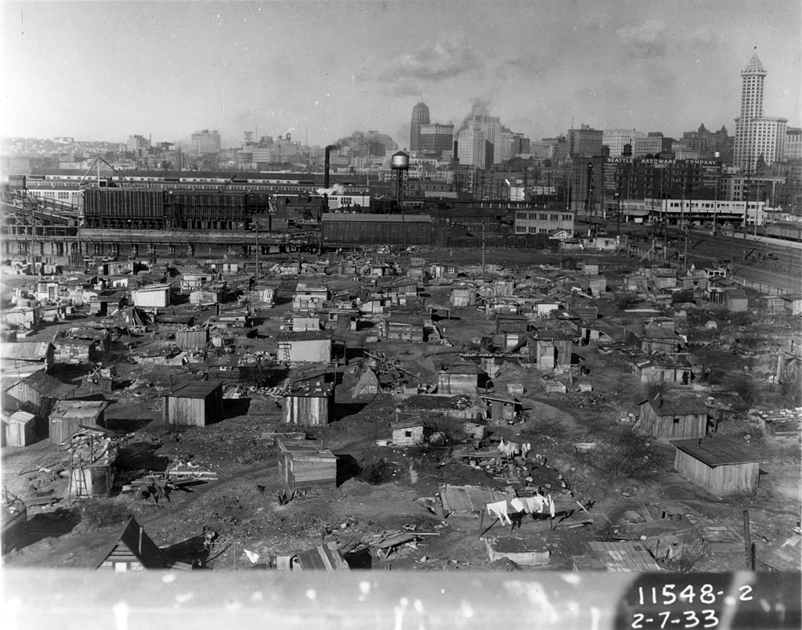
Shanty towns for homeless: Seattle “Hooverville” ….3 million plus homeless by 1932 …rise in evictions and empty houses

Slide 13
“Bonus Army”
Congress awards “Bonus payment to WW1 veterans…payable 1945
Veterans organisations demand early payment
Organise march on Washington 1932

Slide 14
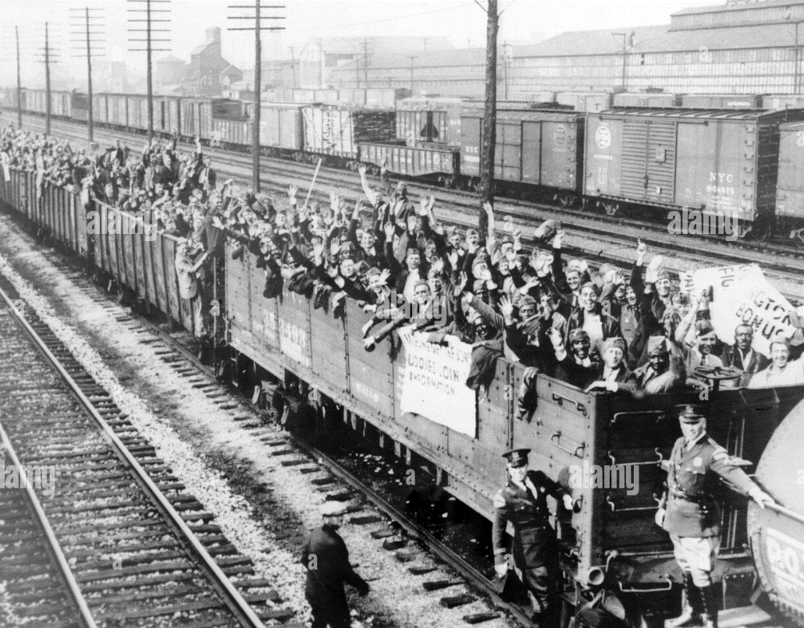
Veterans across US converge on Washington

Slide 15
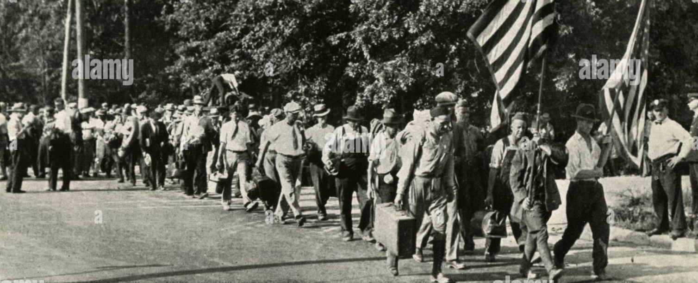
Orderly determined, patriotic march to Capital
Veterans awarded
Bonus in1924
.. Payable 1945
Needed …NOW
50,000 march on
Washington to
Demand early payment

Slide 16
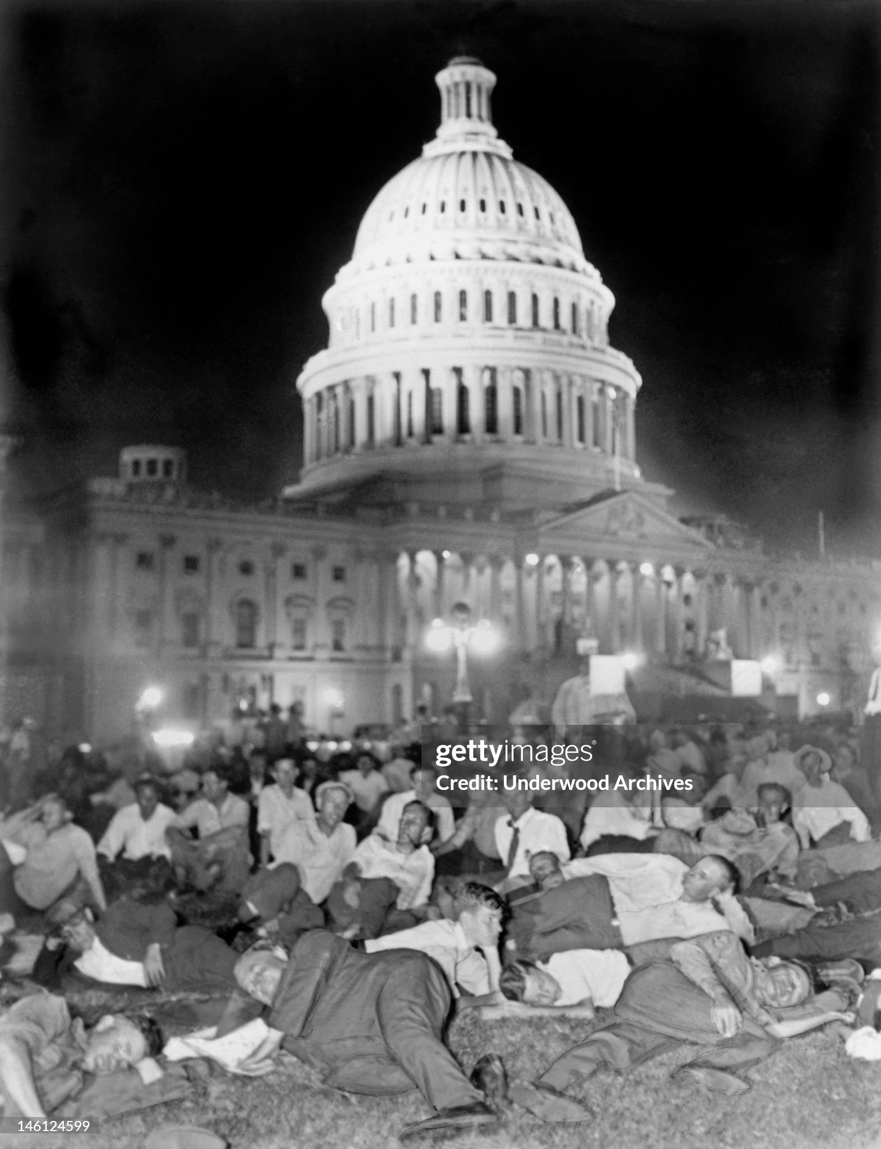
Washington “Hooverville”
Hoover will not meet
With “Bonus Army”
Veterans create
Self contained city of
15,000 on capital lawn
….lending library
….sanitation facilities
Hoover request move
…refused
….orders army in
…Douglas McCarthur
Convinced communist led....tanks, 2 killed

Slide 17
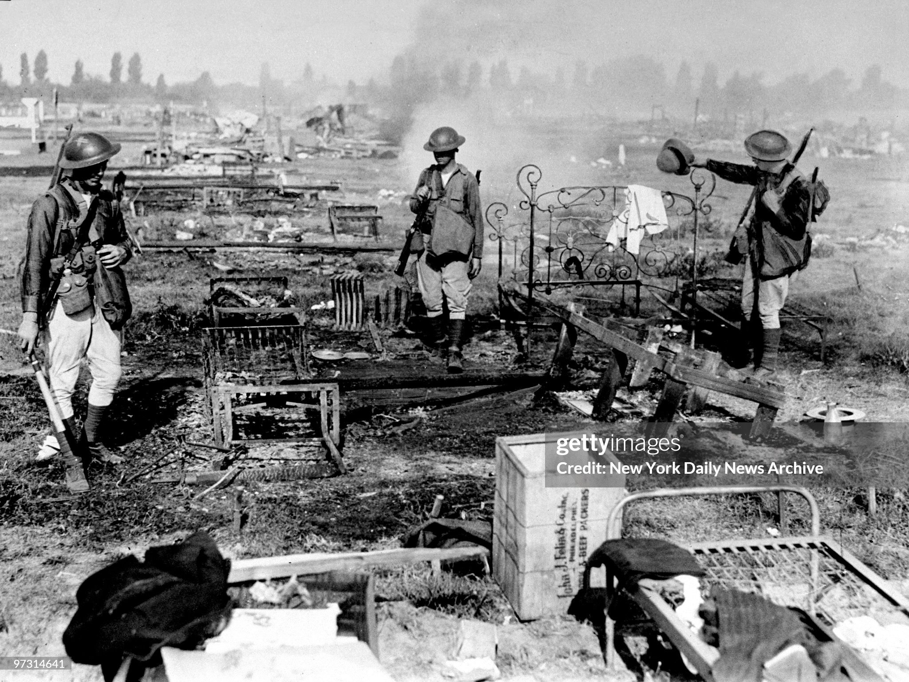
“Hooverville” …after army destroyed …Hoover reputation destroyed

Slide 18
Situation Autumn 1932
3 million homeless, surplus of empty homes due to evictions
Average weekly wage reduced 40% since 1929 ($25 (£450 ) to $15 (£250)
Unemployment 25%and rising
Collapse in confidence, Hoover discredited
“Hoovervilles” surrounding cities, outbreaks of starvation, threat of civil unrest

Slide 19
Governor New York, Franklin Roosevelt
….undertakes major public works
…..nation reputation as someone doing something
….nominated to Democratic Part for Presidential
election of 1932

Slide 20
The Big Rock Candy Mountain …Harry McClintock 1928
One evening as the sun went down And the jungle fires were burning, Down the track came a hobo hiking, And he said, "Boys, I'm not turning I'm headed for a land that's far away Besides the crystal fountains So come with me, we'll go and see The Big Rock Candy Mountains"

Slide 21
In the Big Rock Candy Mountains You never change your socks And the little streams of alcohol Come trickling down the rocks The brakemen have to tip their hats And the railway bulls are blind There's a lake of stew And of whiskey too You can paddle all around em In a big canoe In the Big Rock Candy Mountains

Slide 22
In the Big Rock Candy Mountains All the cops have wooden legs And the bulldogs all have rubber teeth And the hens lay soft-boiled eggs The farmers' trees are full of fruit And the barns are full of hay Oh I'm bound to go Where there ain't no snow Where the rain don't fall The winds don't blow In the Big Rock Candy Mountains

Slide 23
In the Big Rock Candy Mountains, The jails are made of tin. And you can walk right out again, As soon as you are in. There ain't no short-handled shovels, No axes, saws or picks, I'm a goin' to stay Where you sleep all day, Where they hung the Turk That invented work In the Big Rock Candy Mountains I'll see you all this coming Fall In the Big Rock Candy Mountains

Slide 24
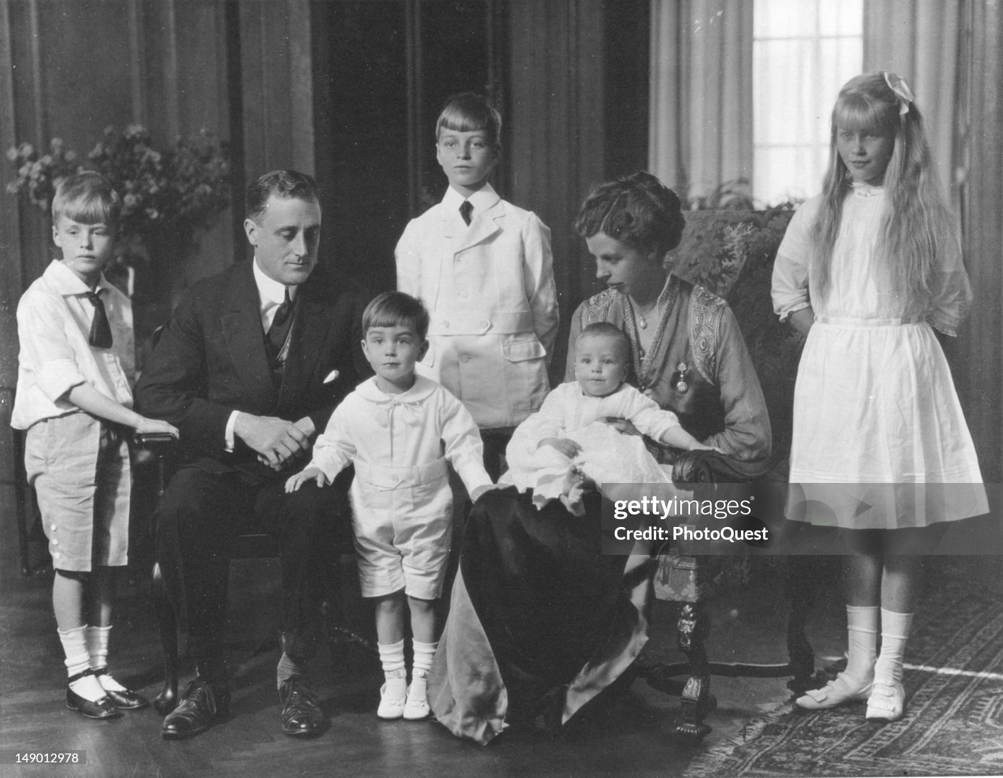
Franklin Delano Roosevelt (1882-1945)
Theodore Roosevelt cousin
The family man 1926
Wealthy established
NY family..home
Schooled till 14
Private boarding School – Harvard’Law School
Career in politics
…funded by Mother’s fortune
…pursues State politics
Marries Eleanor
Roosevelt…cousin
….6 children
….Like minded
….Domineering mother

Slide 25
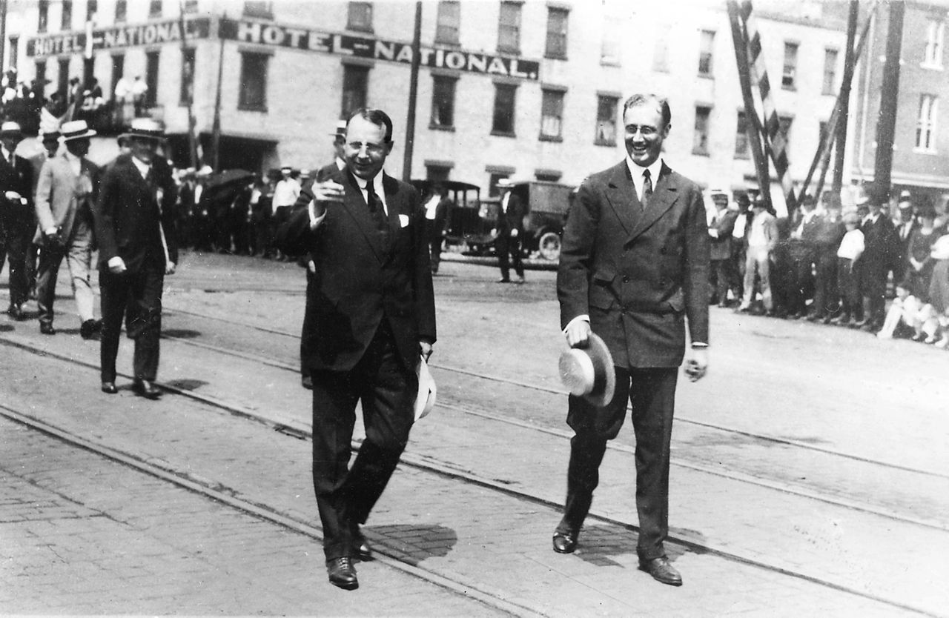
The Rising Star
State Senator
Pro Wilson Democrat
Sec of Navy WW1
Affair with secretary
Lucy Mercer, wants
Divorce, mother forbids
Runs for VP /loses
But rising star
Contract polio
...Paralyzed
..nursed by Eleanor
..partial recovery
This the last known
Picture of FDR
Walking unaided

Slide 26
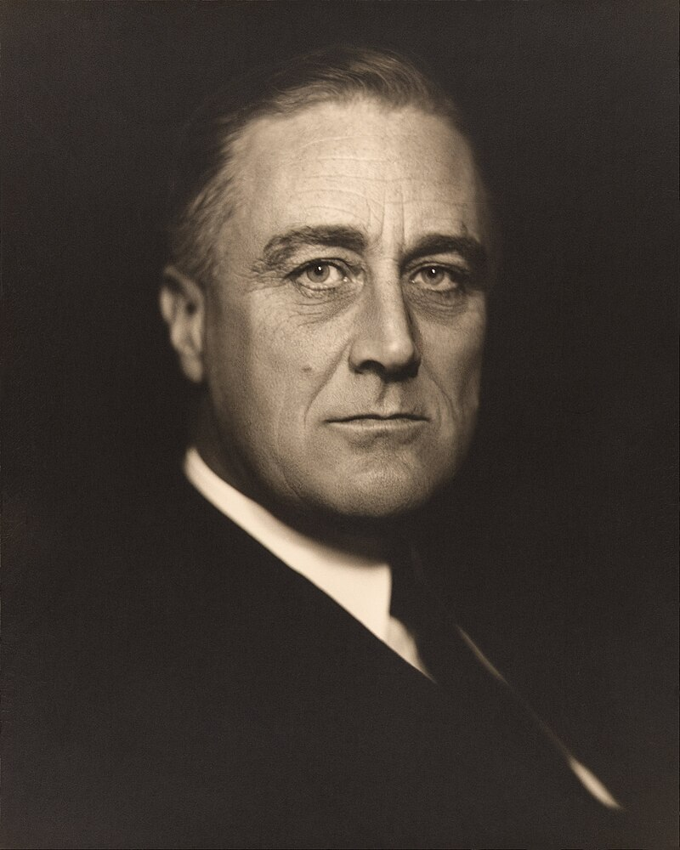
Governor New York
Spends 4 years recovering
Hydrotherapy, reading, …develops ideas to expand League
Roosevelt 1932
Connects with the disabled & poor
…develops partial recovery
…empathy to common man
Returns to politics 1925
…supports Progressive ex Wilson staff
….working relationship with Eleanor
….intellectual not marital partnership
Elected Governor of NY 1928
…fire-side chats developed
..endorses unemployment insurance
..introduces Temporary Relief
…enacts anti corruption probes
…farmer support
Gains national reputation and Dem
Nomination for 1932 election

Slide 27
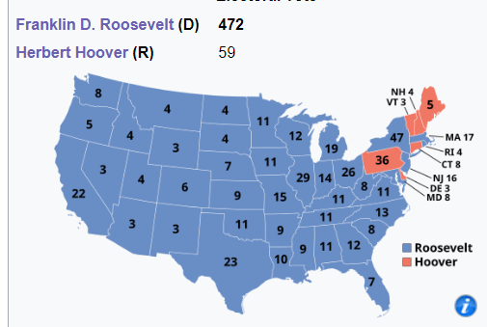
Election of 1932
FDR promises “New Deal”
….government intervention
….civil rights
…lower tariffs
….end Prohibition
Creates “new coalition”
…labour unions
…big cities
…northern blacks (not interference South)
…farmers
…southern whites
Wins landslide 472 vs 59 electoral votes
…..57% of popular vote
Wins Senate and House majorities

Slide 28
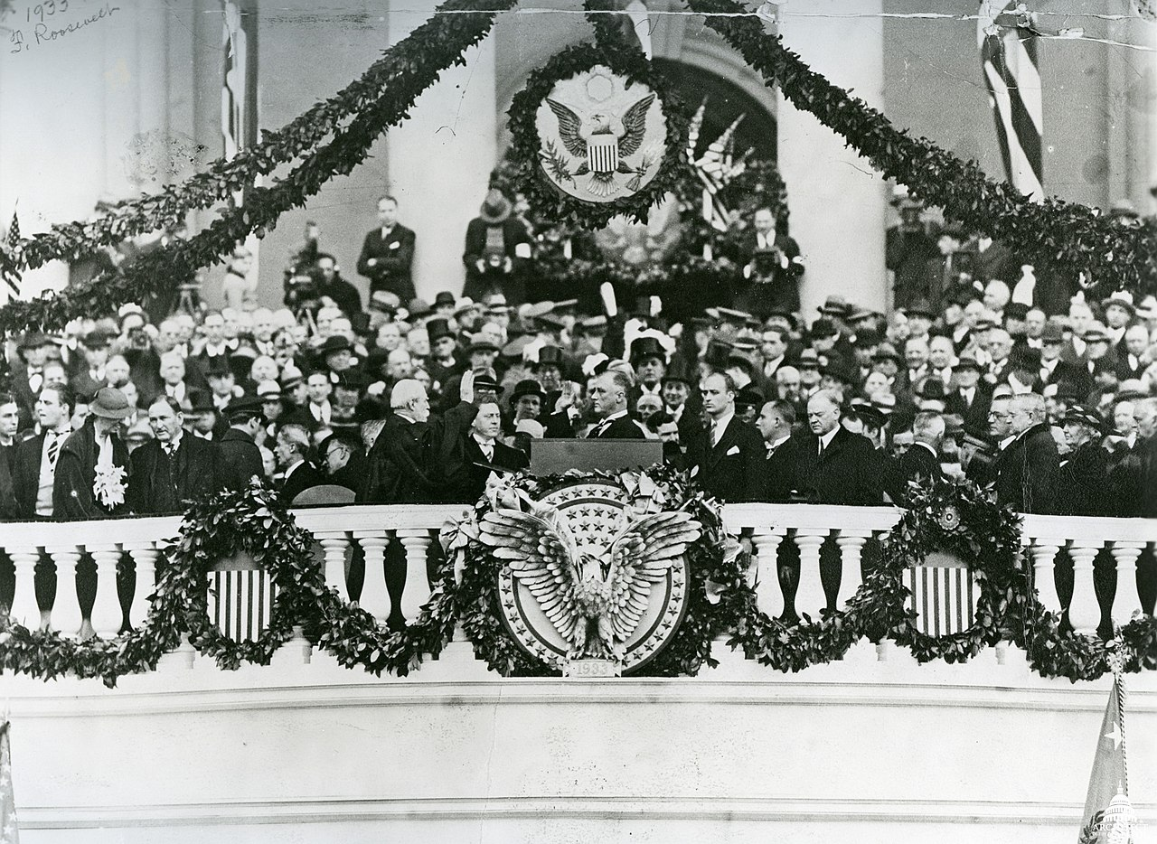
Inauguration Speech March 1933
Recruits “Brain Trust”..Harvard
Yale…to work up plan to stop
Depression
Assassination attempt February ….Chicago mayor killed, dies in FDR arms.
….”I’m glad it’s me, no you”
…Woman with purse stops assassin

Slide 29
“This great Nation will endure as it
has endured, will revive and will
prosper. So, first of all, let me assert
My firm belief that the only thing we
have to fear is fear itself”
Relief, Recovery, and Reform

Slide 30
First act….authorise repeal of Prohibition
Inaugurated March 7th
Passes bill authorising 21st Amendment to be sent to states March21st
Executive order allowing consumption of low alcohol beer March 22nd
2/3 state approve repeal….alcohol December 1933

Slide 31
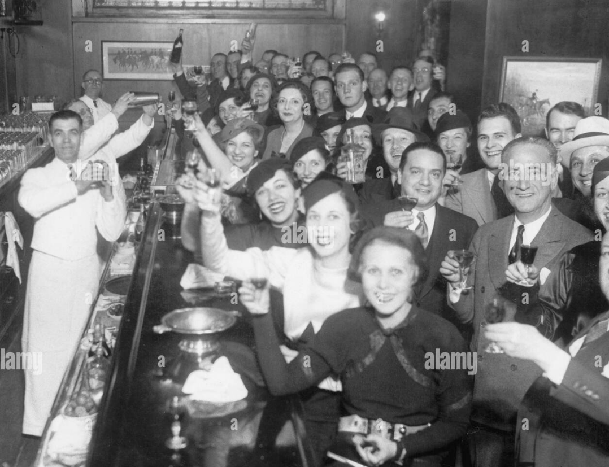
A night to remember. January 1st 1934

Slide 32
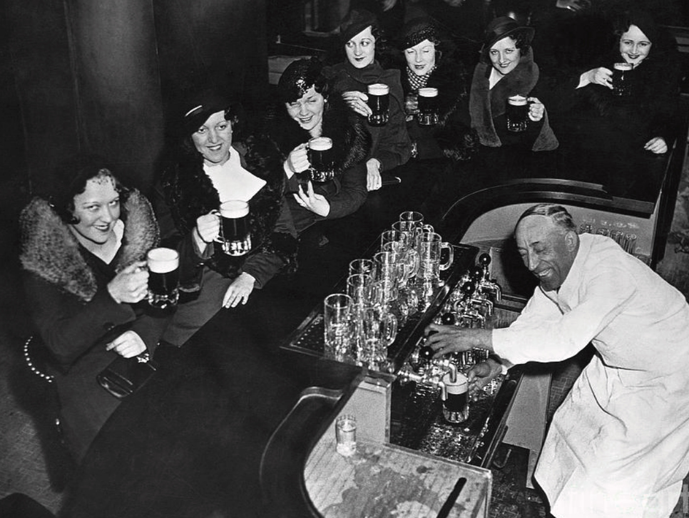

Slide 33
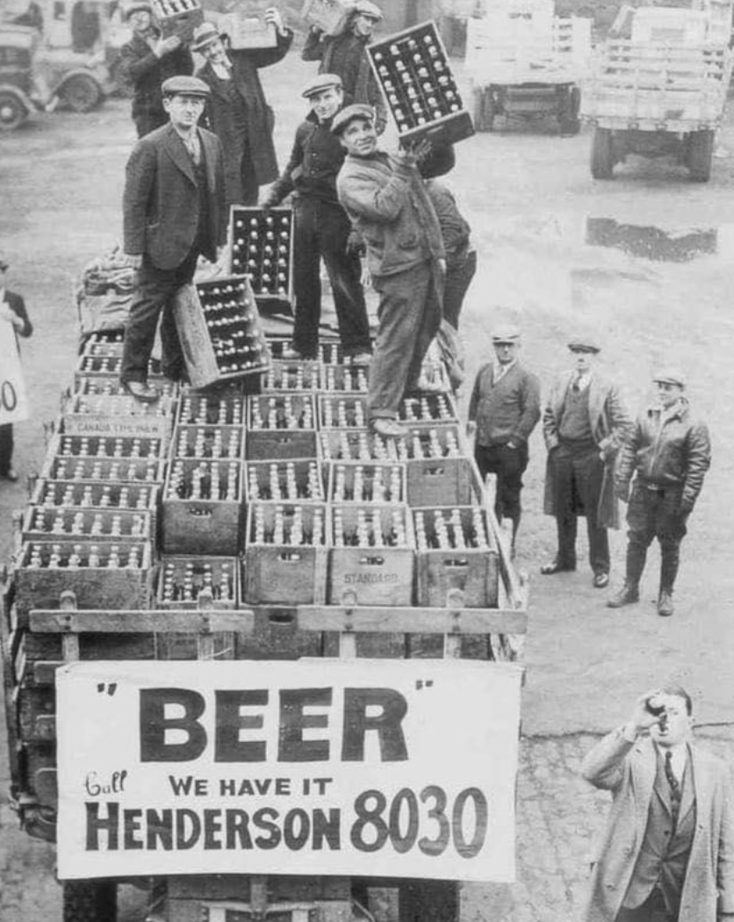

Slide 34
The 100 days and First New Deal
Convenes Congress immediately for 3 month session
15 major new legislation passed…THE NEW DEAL
Banking Reform
Civilian Conservation Corps
Agricultural Adjustment Act
Emergency Relief …Public Works Administration
National Industrial Recovery Act
Accompanied by weekly “fire side chats” and aggressive propaganda
Unprecedented increase in Government impact to daily life
….Roosevelt “Try it , fail, fix it, start again…but for God’s sake act”

Slide 35
Banking Reform Act (Glass Steagall)
Closes all banks 4 days
Authorises funding for all banks…establishes Deposit Insurance
Criminalises possession of gold coins
Firewall established retail and merchant banks
Fire-side chat the night before banks re-open
Banks reopen
Nothing happens…Panic over

Slide 36
Civilian Conservation Corps
Immediate launching of Government funded work schemes
Paid $35 per month, $25 to be sent home, free room and board
Tree breaks across Dust bowl, reforestation, national parks
300,000 employed each year…3 million employed during 10 year programme…racially segregated to retain White South buy-in
Army run…orderly, fair, productive
Universally acclaimed as a great success….and still is

Slide 37
National Industrial Recovery Act
Regulate competition
Enable creation of monopolies
Federal Boards set prices and wages
Rules to manage ways of working, customer preference
Sets Minimum wage
Abolishes child labour
Fixed working hours…by industry
… US becomes a “planned economy”…within 1 year
… Opposition led by Hoover claims “Un American
…..Many stlll do: …….. “Birth of Deep State”

Slide 38
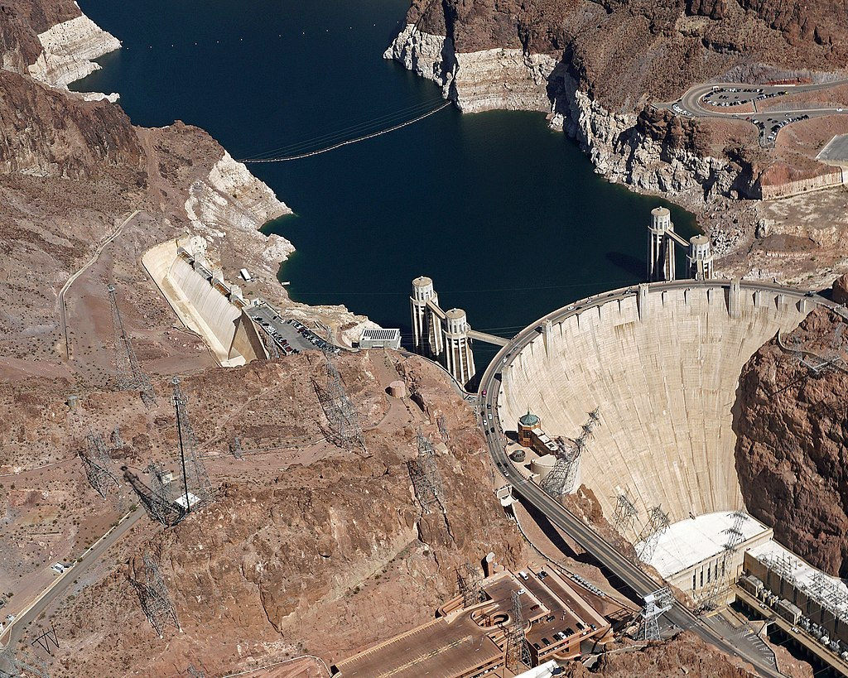
Hoover Dam(completed 1934, 1 year early & under budget….creates dry farming…and Las Vegas

Slide 39
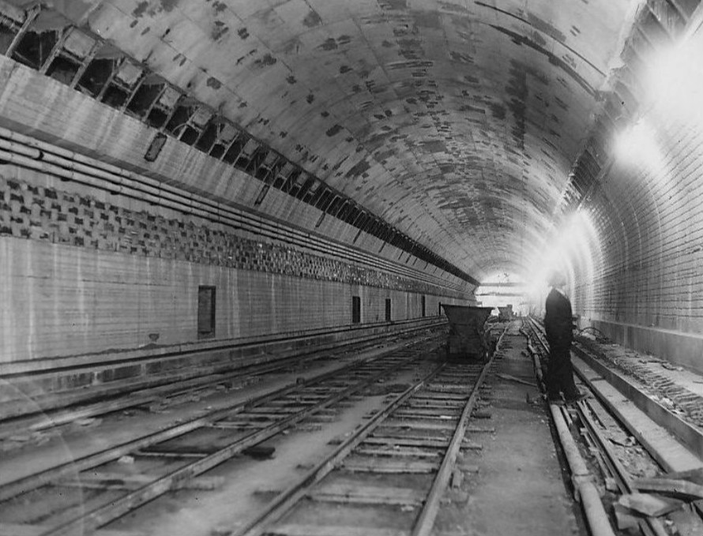
Lincoln Tunnel New York

Slide 40
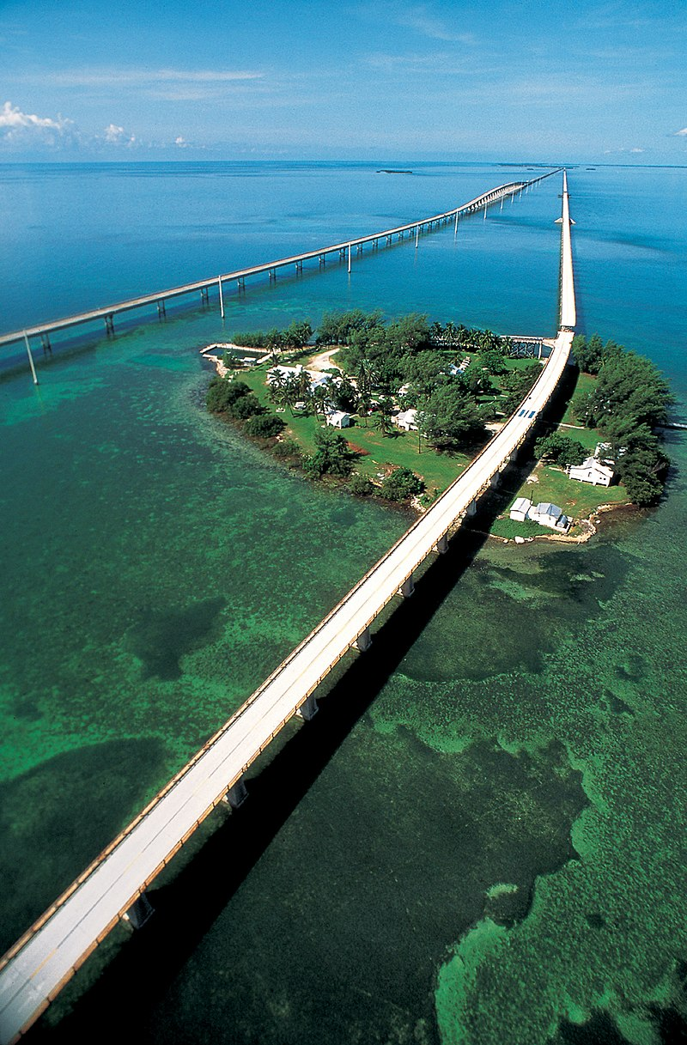
7 mile bridge….Key West to Florida

Slide 41
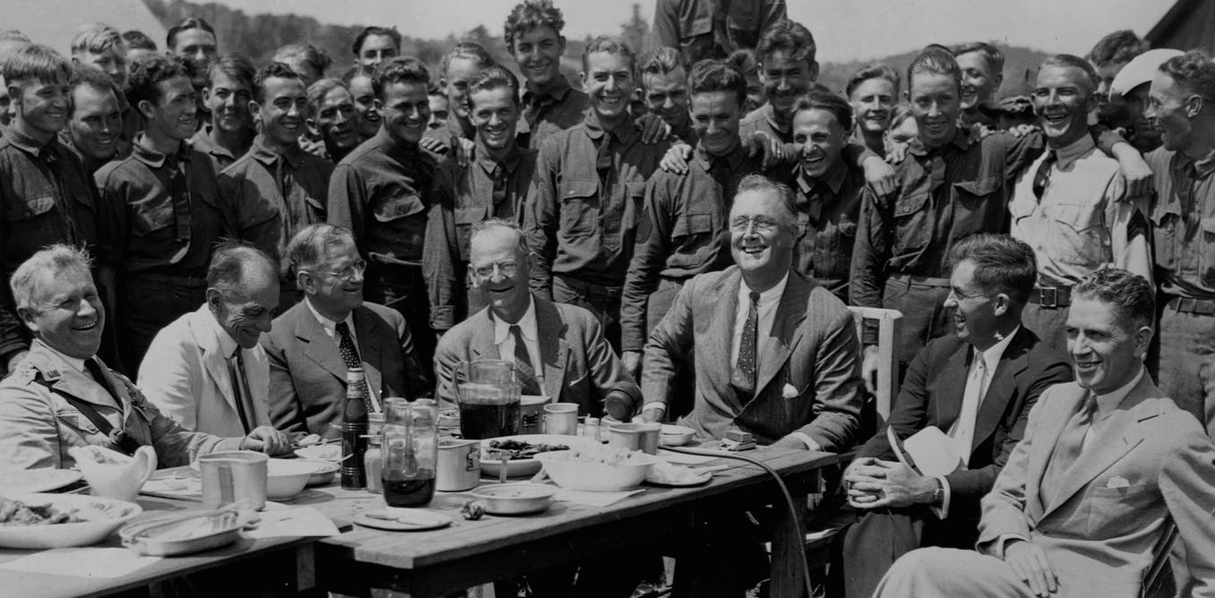
Roosevelt everywhere (always seated) At CCC Camp summer of 1933…notice all white

